Slide 1

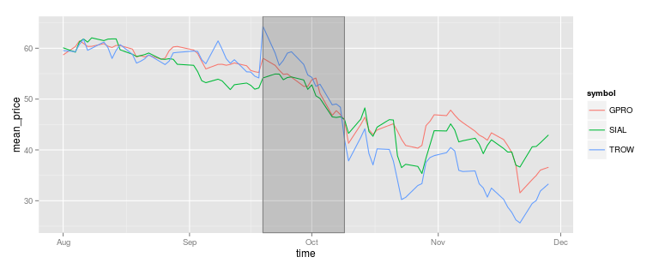
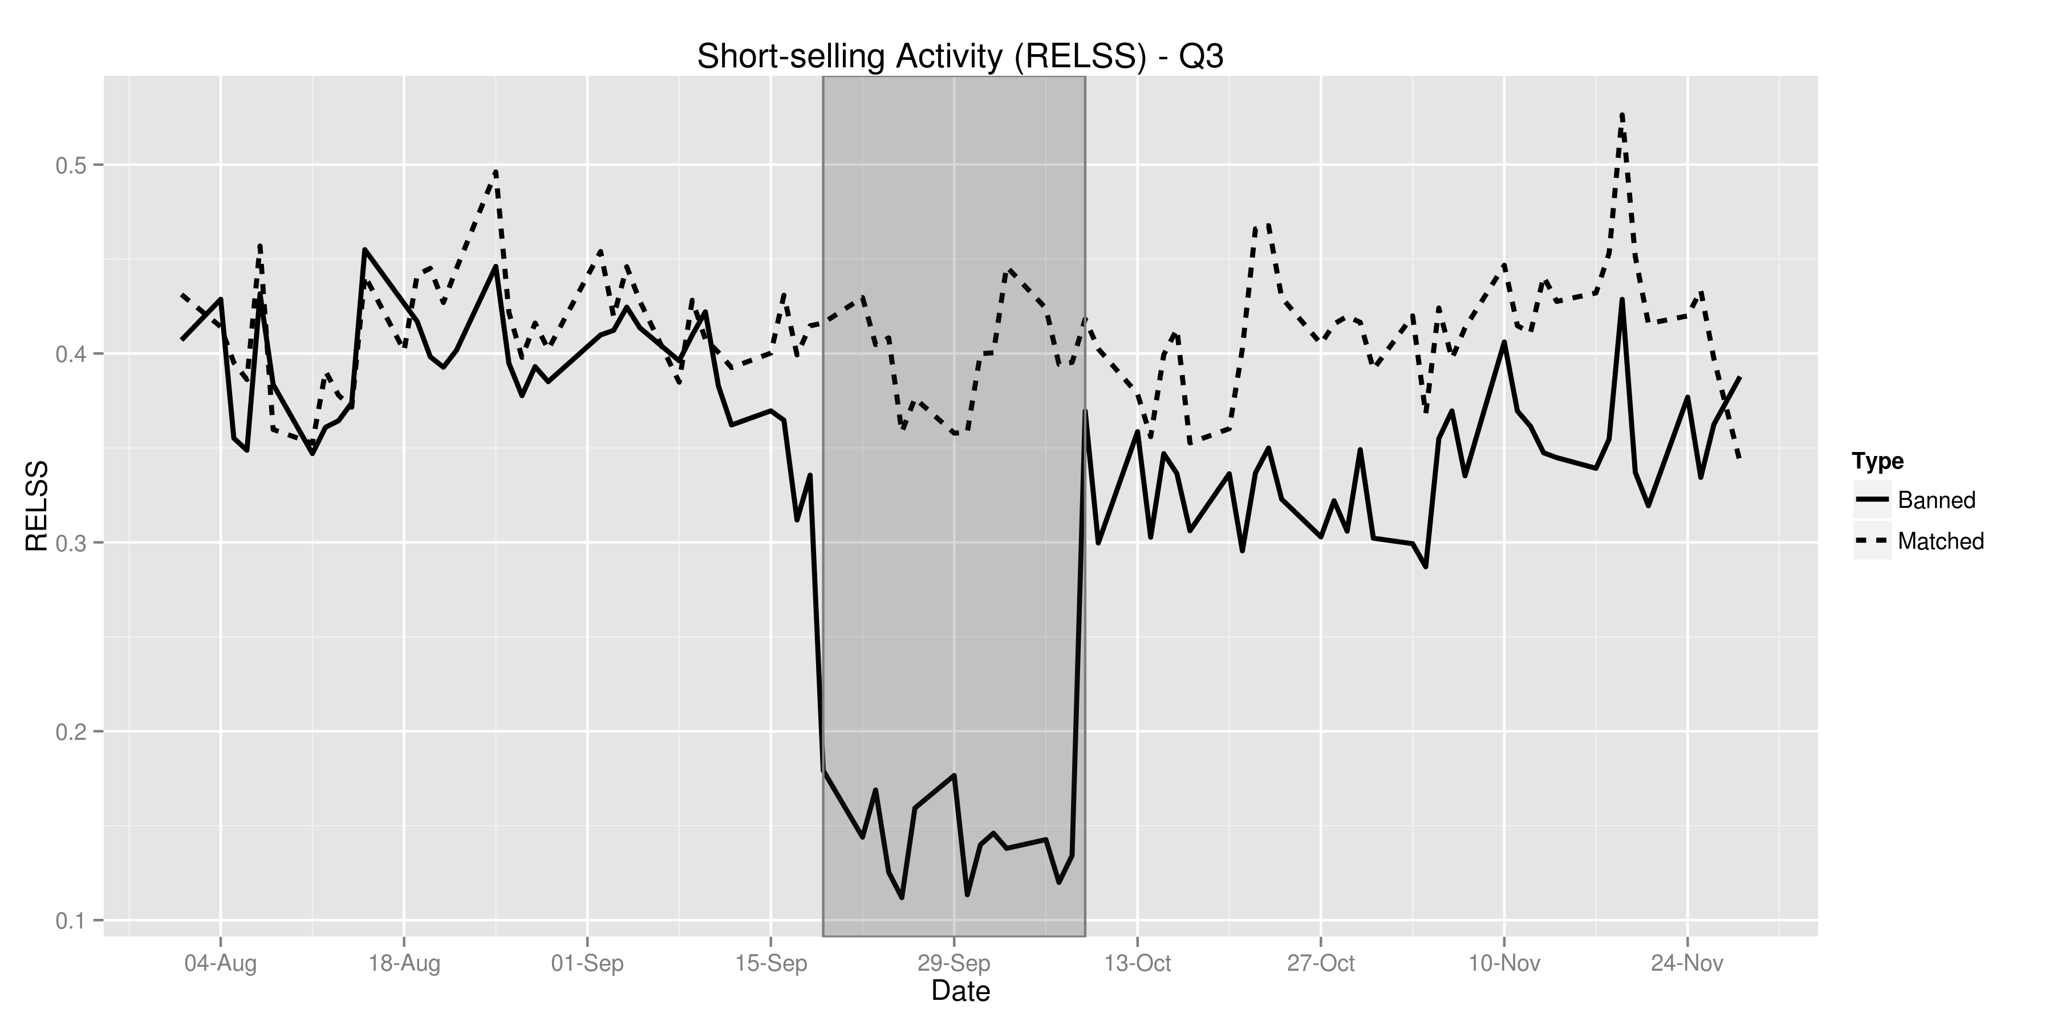
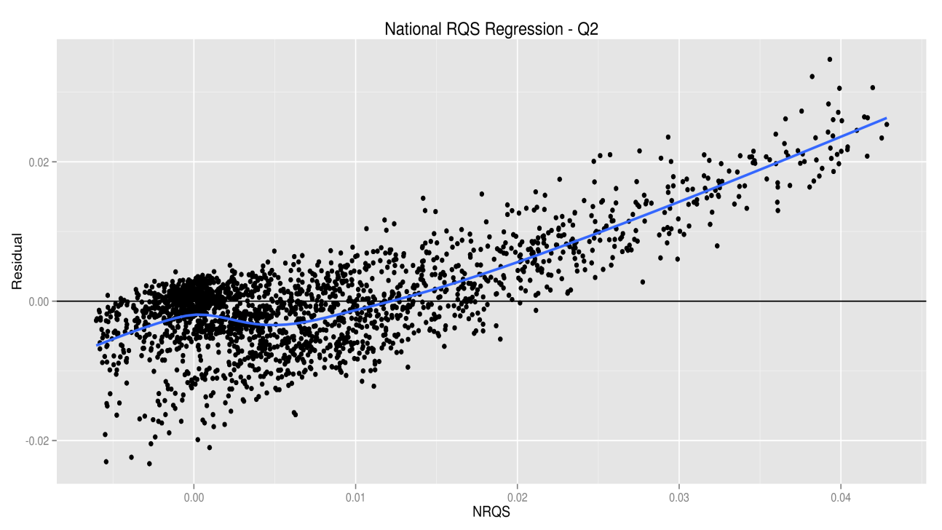

The Need for Speed: High Frequency Finance and Short Selling
Jonathan Gillett ● Ryan Riordan ● Jonathan Brogaard Faculty of Business and IT ● University of Ontario Institute of Technology ● Oshawa, Ontario, Canada
Introduction
Results
The goal of the research was to better understand the impact of the short-selling activities of high frequency traders (HFT) on market liquidity and efficiency.
Two NASDAQ databases were used, containing more than 1000 stocks over a four month period that includes a ban on short-selling during the recent financial crisis.
Our findings will help regulators, investors and market operators to better understand the impact of regulations restricting short-selling and the impact of HFT before, during and after regulatory interventions.
Methodology
Data Processing
NASDAQ
TAQ
Database Identifying HFT and Short-Sales
Trade And Quote Database
Merge NASDAQ HFT data with short-sales and TAQ
Aggregate data (time and trade weighted) for analysis
Data Analysis
Calculate market quality measures and descriptive statistics
Match banned stocks to a control group of unbanned stocks based on price, volume and market capitalization
Conclusions and Further Research
Visualization of market quality measures and descriptive statistics to aid in creating the initial design of the statistical models for regressions
Statistical Modelling
References
Creation of statistical models
Assessment of models based on regression analysis with datasets
Models do not accurately explain the results based on the datasets
Acknowledgements
Models explain the results with statistical significance
$RQS \sim ssb+market_{cap}+sum_{vol}+ hft_a + hft_a ∗ ssb$
Notes:
1

